Slide 1
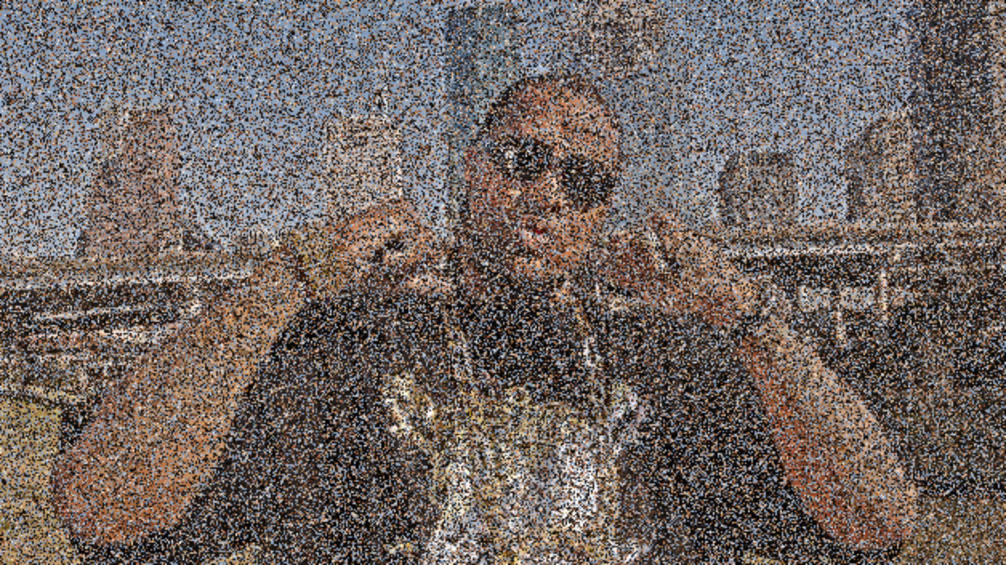
MMP 210
Multimedia Programming 1

Slide 2
Instructor: Kyle Greenberg
Email: kgrnbrg@gmail.com [for now]
Schedule: Tuesdays, 2:00PM-5:40PM
Room: FH-706
Office Hours by appointment or directly after class
Room: TBD
Skype: kgrnbrg

Slide 3
github.com/kgrnbrg/mmp210/wiki

Slide 4
Grading
Teacher evaluation and class performance: 10%
Homework assignments: 40%
Midterm project: 15%
Final project: 20%
Quizzes: 15%
Assignments must be handed in on time. Points will be deducted on work handed in late. Assignments may not be accepted for grading if they are late.

Slide 5
Attendance
At BMCC, the maximum number of absences is limited to one more hour than the number of hours a class meets in one week. In the case of excessive absences, the instructor has the option to lower the grade or assign an F or WU grade.

Slide 6



Software

Slide 7
Computer Labs
• 199 Chambers, Room N-261
◦ Hours: Mon-Thu: 8am-12am, Fri: 9am-12am, Sat-Sun: 8:30am-12am
• 70 Murray Street, Room. M-1109
◦ Hours: Mon-Thu: 9am-8pm, Fri: 9am-3pm
• 245 Greenwich (Fiterman), Room LL03
◦ Hours: Mon-Fri: 8am-10pm, Sat-Sun: 8:30am-1:30pm
More info here : www.bmcc.cuny.edu/it/

Slide 8
Slack
MMP2F2016.slack.com

Slide 9
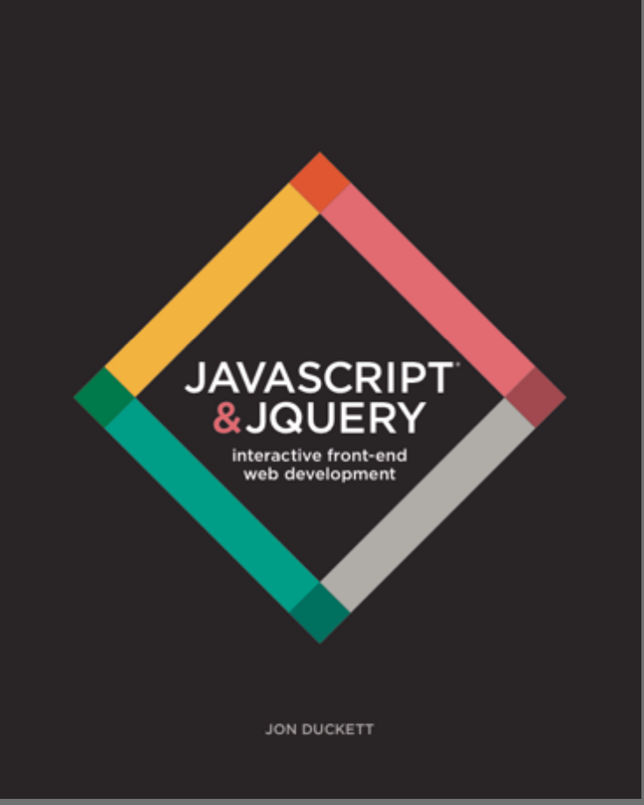
“JavaScript and JQuery: Interactive Front-End Web Development” by Jon Duckett, Publisher: John Wiley & Sons, Inc. ISBN-13: 978-1118531648
If you are serious about coding buy this book

Slide 10
Grades?

Slide 11
Who am I?

Slide 12
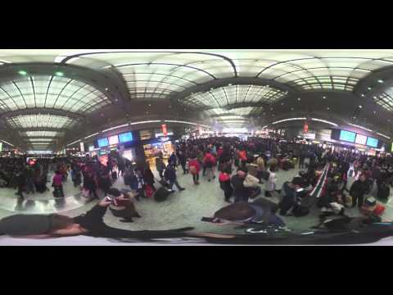
Quick Facts
Born and raised in NYC
Spent last year in Shanghai, China working for NYU
Got my masters from NYU’s Interactive Telecommunications Program
Huge New York Knicks fan
Currently researching hacking higher education, 360 video, and telepresence

Slide 13
Who are you?

Slide 14
Interview your neighbor using the questions listed below
(feel free to add your own):
First name, standing, major
Three things about you (i.e: favorite team that ends with York Knicks, where are you from, favorite food, hobbies etc…)
Your three favorite pieces of media (i.e: TV shows, Video Games, Movies, Magazines, Websites, Tumblrs, etc…)
What do you hope to learn in this class?
Be prepared to present your neighbor to the class.

Slide 15
Topics
Notes:
Programming Basics
Statements
Control Structures
expressions
functions
methods
objects
variables
JavaScript syntax and best practices
Document Object Model (DOM)
Object oriented coding
Interactivity with events, keyboard and mouse input
APIs
HTML5
Canvas and graphics
Multimedia elements
Web Applications

Slide 16
Topics
Programming Basics
Statements
Control Structures
Expressions
Functions
Methods
Objects
Variables
JavaScript syntax and best practices
Document Object Model (DOM)
Object oriented coding
Interactivity with events, keyboard and mouse input
APIs
HTML5
Canvas and graphics
Multimedia elements
Web Applications

Slide 17

Let’s get started!

Slide 18
What is HTML5?

Slide 19
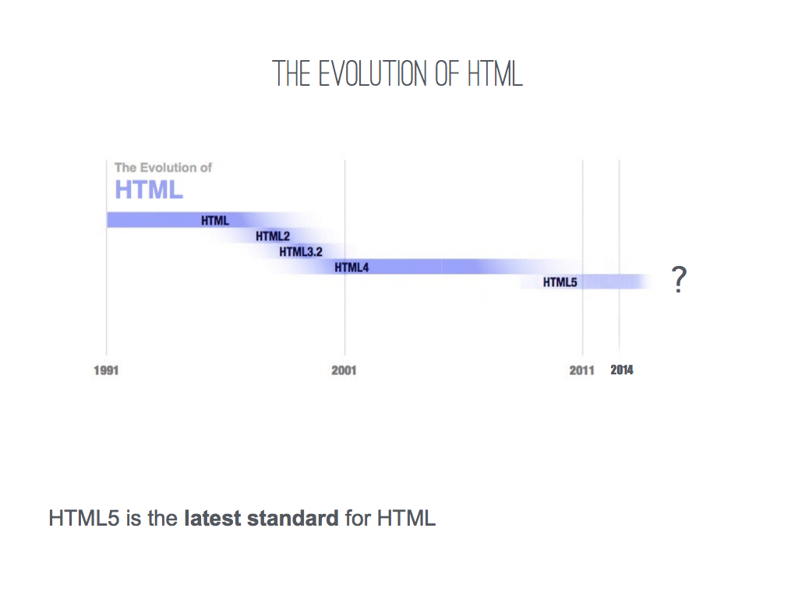
Notes:
is a markup language used for structuring and presenting content on the World Wide Web. It is the fifth and current version of the HTML standard.

Slide 20
W3C
The World Wide Web Consortium (W3C) is an international community where Member organizations, a full-time staff, and the public work together to develop Web standards.

Slide 21
“Benefits”
HTML5 retains backwards compatibility with previous versions of HTML
HTML5 has new structural elements (i.e: <header>, <nav>, <section> etc..)
HTML5 added new media elements (i.e: <video>, <audio>, <embed> etc...)
HTML5 contains many features to facilitate the development of web applications

Slide 22
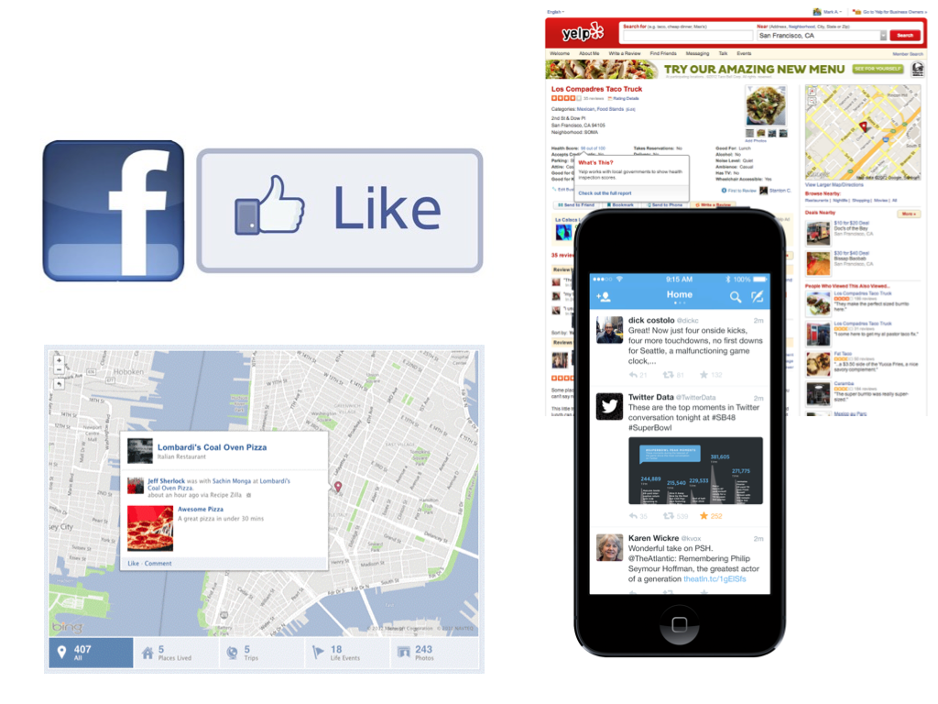

Slide 23
What is HTML5?

Slide 24

Hyper Text Markup Language
Notes:
hyper text markup language
A markup language is a system for annotating a document in a way that is syn-tactically distinguishable from the text.The idea and terminology evolved from the "marking up" of paper manuscripts, i.e., the revision instructions by editors, traditionally written with a blue pencil on authors' manuscripts.

Slide 25
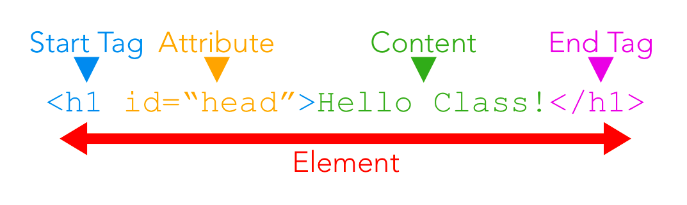
Notes:
HTML can be broken down into these four components.
Elements are the basic structure of an HTML document.
Like other markup languages, HTML uses brackets like this: < > to divide content and tags. Tags tell the browser what to do with the content. Some elements have an open tag and closing tag.
The content always goes in between the tag. This can include text, other forms of media and other HTML elements.
Inside of the tags we can also add attributes which add information or functionality to elements with a name and value pair.
HTML elements are nested inside each other to create simple and complex structures. If an HTML tag is opened inside of another HTML tag, it must be closed before it's parent tag is closed.

Slide 26
<html>
</html>
Notes:
For review
created an area where we put content

Slide 27
<html>
<body>
</body>
</html>
Notes:
Add another tag known as body contains all of the content and structure that goes on the page.

Slide 28
<html>
<h1> Coding Rulz </h1>
<body>
</body>
</html>
Notes:
Add a h1 - title of the page

Slide 29
<html>
<h1> Coding Rulz</h1>
<body>
<p>
</p>
</body>
</html>
Notes:
P tag for paragraph

Slide 30
<html>
<h1> Coding Rulz </h1>
<body>
<p>
<img src = “kyle.jpg”>
</p>
</body>
</html>
Notes:
<img src “apple.jpg”>

Slide 31

Coding Rulz
Notes:
Ok great

Slide 32
The basic structural tags of HTML include doctype, html, head and body
doctype tells the browser what type of document it is reading.
html is a wrapper for the all of the content in the document.
head contains information that is invisible to the user, such as meta information about the page, links to stylesheets and scripting, and other functionality.
body contains all of the content and structure that goes on the page.
div is a basic element that stand for division. It is used as a neutral building block for position and creating hierarchy with a page.
Structural tags

Slide 33
Text tags
Tags for text include:
h1, h2, h3, h4, h5, h6 are headings, such as the title of these slides, the higher the number the smaller the font and weight
p is the paragraph tag, which is used to organize most text
em, strong are style tags, emphasis for italics and strong for bold.
ul, ol, li are used to create lists such as this one. ul is unordered list, which makes a list with bullets. ol is ordered, for numbers. li is a list item. They are useful for navigation menus.
Notes:
MDN Intro to HTML
MDN Element Reference

Slide 34
Hyperlinks
a is the anchor tag, for hypertext links. It requires the href attribute to hold the location or URL of the link. It also takes the target attribute to determine where to open the link, such as "blank" for a new window.
External links are links to pages on other sites:href="http://www.othersite.net"
Internal links are links to pages within the same site, server or domain, and use relative paths: href="work/assignment1/index.html"

Slide 35
CSS
Cascading Style Sheets
Notes:
CSS stands for Cascading Style Sheets. It was first proposed in 1994 to define visual styles for HTML pages on the World Wide Web but took time to gain acceptance, though eventually becoming standard.
"Cascading" refers to the way the style are implemented, with external, internal and inline style rules being applied to pages in order.
CSS uses selectors to target elements and add visual styles. Any HTML element, such as body or p can be used as a CSS selector, although the default styles and behaviors of HTML elements vary. Every selector has one or multiple values that define a corresponding property.
CSS defines rules for the colors, fonts, dimensions and positions of elements on a web page.

Slide 36
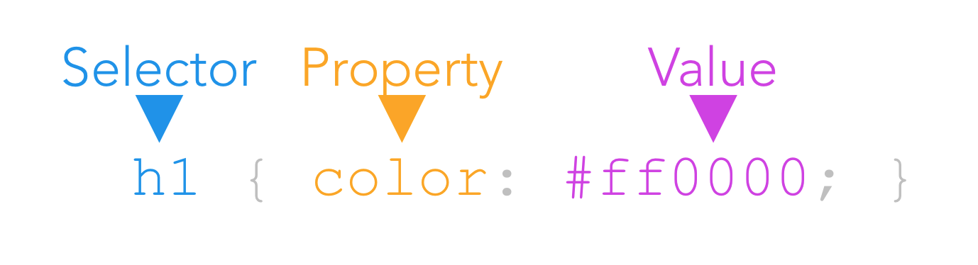
Declaration
Notes:
Each CSS rule has a selector and a declaration. The selector indicates which HTML element(s) the rules apply to. The declaration defines how those elements should appear. Each declaration has a property (the aspect you want to control) and a value.
There are three ways to include CSS styles in an HTML document.

Slide 37
<link rel="stylesheet" href="style.css" type="text/css" />
Notes:
External stylesheets are linked into the HTML page by a tag. These styles can be applied to multiple HTML pages:

Slide 38
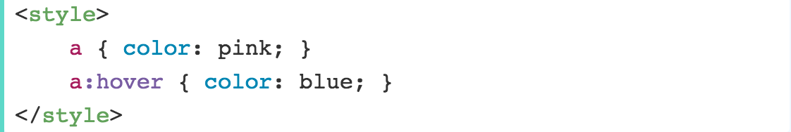
Notes:
Internal stylesheets can be added anywhere inside of an HTML document, using the style tag, but are typically found in the <head> section. These styles will only apply to elements on a single page, but will apply to all elements of that page.

Slide 39
Notes:
Inline styles are added inside of an HTML element as an attribute and will apply to that element only.

Slide 40
Notes:
Inline styles are added inside of an HTML element as an attribute and will apply to that element only.

Slide 41
Coding Rulz
Notes:
HTML + CSS

Slide 42
Coding Rulz
Hey!
Notes:
HTML + CSS + Javascript

Slide 43
What is Javascript?

Slide 44
JavaScript is the programming language of the web.
It encompasses many of the traditional rules of programming and can make a web page more interactive by responding to a user’s actions.

Slide 45
Programming is the process of creating a set of instructions to enable the computer to complete a task.

Slide 46
A script is a series of instructions that a computer can follow to achieve a goal.
A browser may use different parts of the script depending on how the user interacts with the web page.

Slide 47
HOW TO WRITE A SCRIPT?
1. DEFINE THE GOAL
2. DESIGN THE SCRIPT
Split the goal out into a series of tasks that will allow the computer to reach the defined goal.
3. CODE EACH STEP
Each task needs to be written in a programming language that the computer understand - in our case, JavaScript

Slide 48
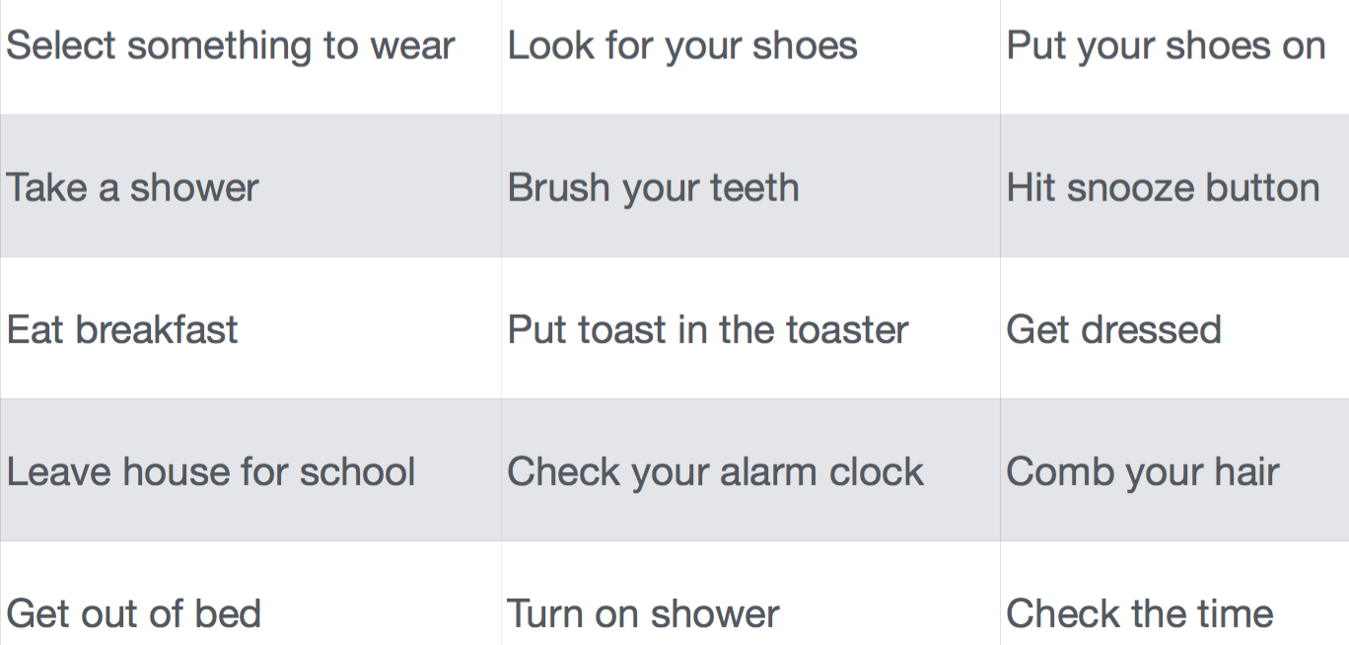
In Class Exercise
Organize this list of tasks to describe how to get up and get to class in the morning. Make sure you use a diamond when a decision needs to be made.

Slide 49
WHAT CAN JAVASCRIPT ADD TO OUR WEBPAGES?
JavaScript allows us to change the content of an HTML page while it is loaded in the browser.
Scripts can include instructions to:
Access the content of the page
Modify the content of the page
Program rules or instructions the browser can follow
React to events triggered by the user of browser

Slide 50
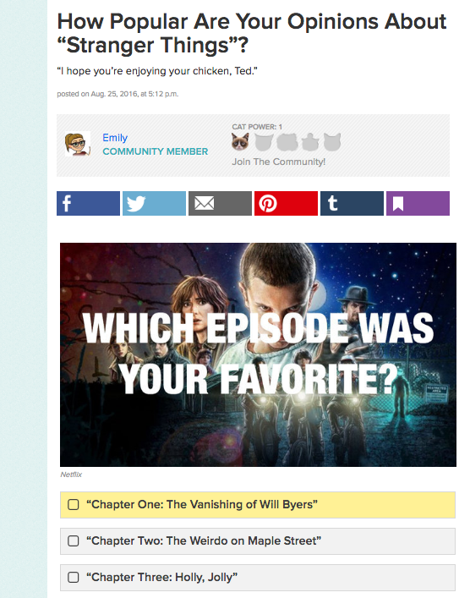
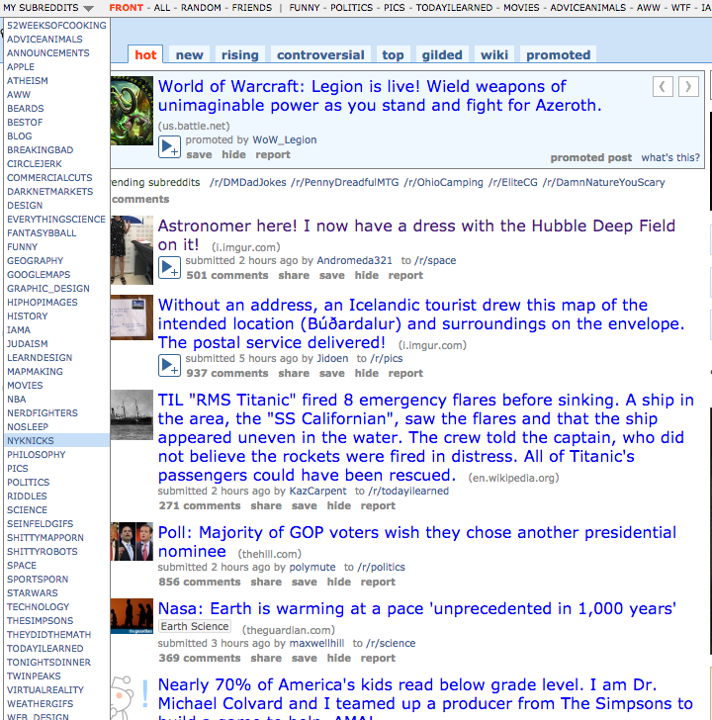
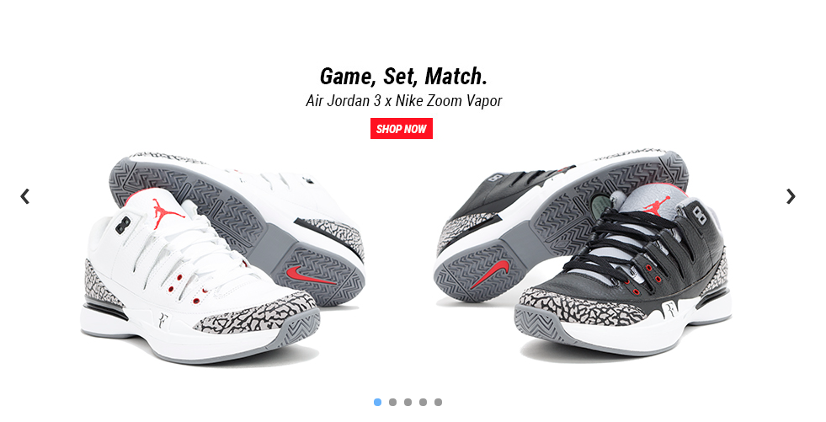

Slide 51
.html
.css
.js
Content
Presentation
Behavior
Notes:
Each language forms a separate layer with a different purpose. Where possible, aim to keep the three languages in separate files.

Slide 52
The HTML <script> element is used to tell the browser to load the JavaScript file.
Notes:
When a browser starts to download a JavaScript file, it stops other downloads and pauses laying out the page until the script has finished loading and been processed.
It is considered best practice to place the script tag just before the closing </body> when possible. This will prevent the .js file affecting the rendering of the rest of the page.

Slide 53
Comments
In HTML, a comment can be written using this syntax:
<!-- COMMENT TEXT GOES HERE -->
In CSS, comments use this syntax:
/* COMMENT IS HERE */
Notes:
In code, comments are sections of the program that are not read by the compiler. Different languages use different conventions to separate comments within the language of the program. These are used by developers to note what the code is doing for other developers or for future reference.
It's extremely important to comment your code with useful comments. If you use any sources please put them in the comments

Slide 54
Any Questions so far?

Slide 55
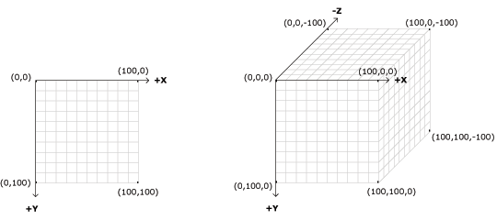
Cartesian Coordinate System
Notes:
https://en.wikipedia.org/wiki/Cartesian_coordinate_system

Slide 56
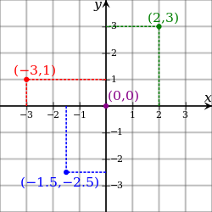
Cartesian Coordinate System
Notes:
https://en.wikipedia.org/wiki/Cartesian_coordinate_system

Slide 57
HTML5 Canvas
The HTML5 Canvas is a relatively new HTML element introduced with the HTML5 standard around 2011 to implement graphical programming within the web browser.
The canvas can be used to draw graphics on the screen using JavaScript. This can be done in pure JavaScript but there are many libraries that make drawing to the canvas easier.

Slide 58
Notes:
One such library is p5 which we will use in this class to learn some programming basics.
Today we're going to get started by adding the p5 library to our web page and playing with some of the functionality.

Slide 59
Homework
Send me an email (kyle.greenberg@nyu.edu) so I can invite you to the slack channel
Create a website that is a self portrait, as well as space that you can use as a portfolio. It should include:
Image
Stylesheet
Text
Bonus points Menu & p5
Watch these Daniel Shiffman Coding Rainbow

